Slide 1
Solar Computing
Giovanni Lostumbo - September 2024

Slide 2
Just one type of energy autonomy/harvesting for PC- others are RF, Thermal, Vibration, but less efficient
Sun rays reach a small solar panel on the computer chassis and charge a capacitor/battery
A hybrid capacitor (Lithium Ion Capacitor, Sodium Ion Capacitor) can store charge like a small battery, but charge quick like a capacitor
Use Cases: (next slide) -->
Solar Computing- What is it?

Slide 3


Use Cases

Slide 4

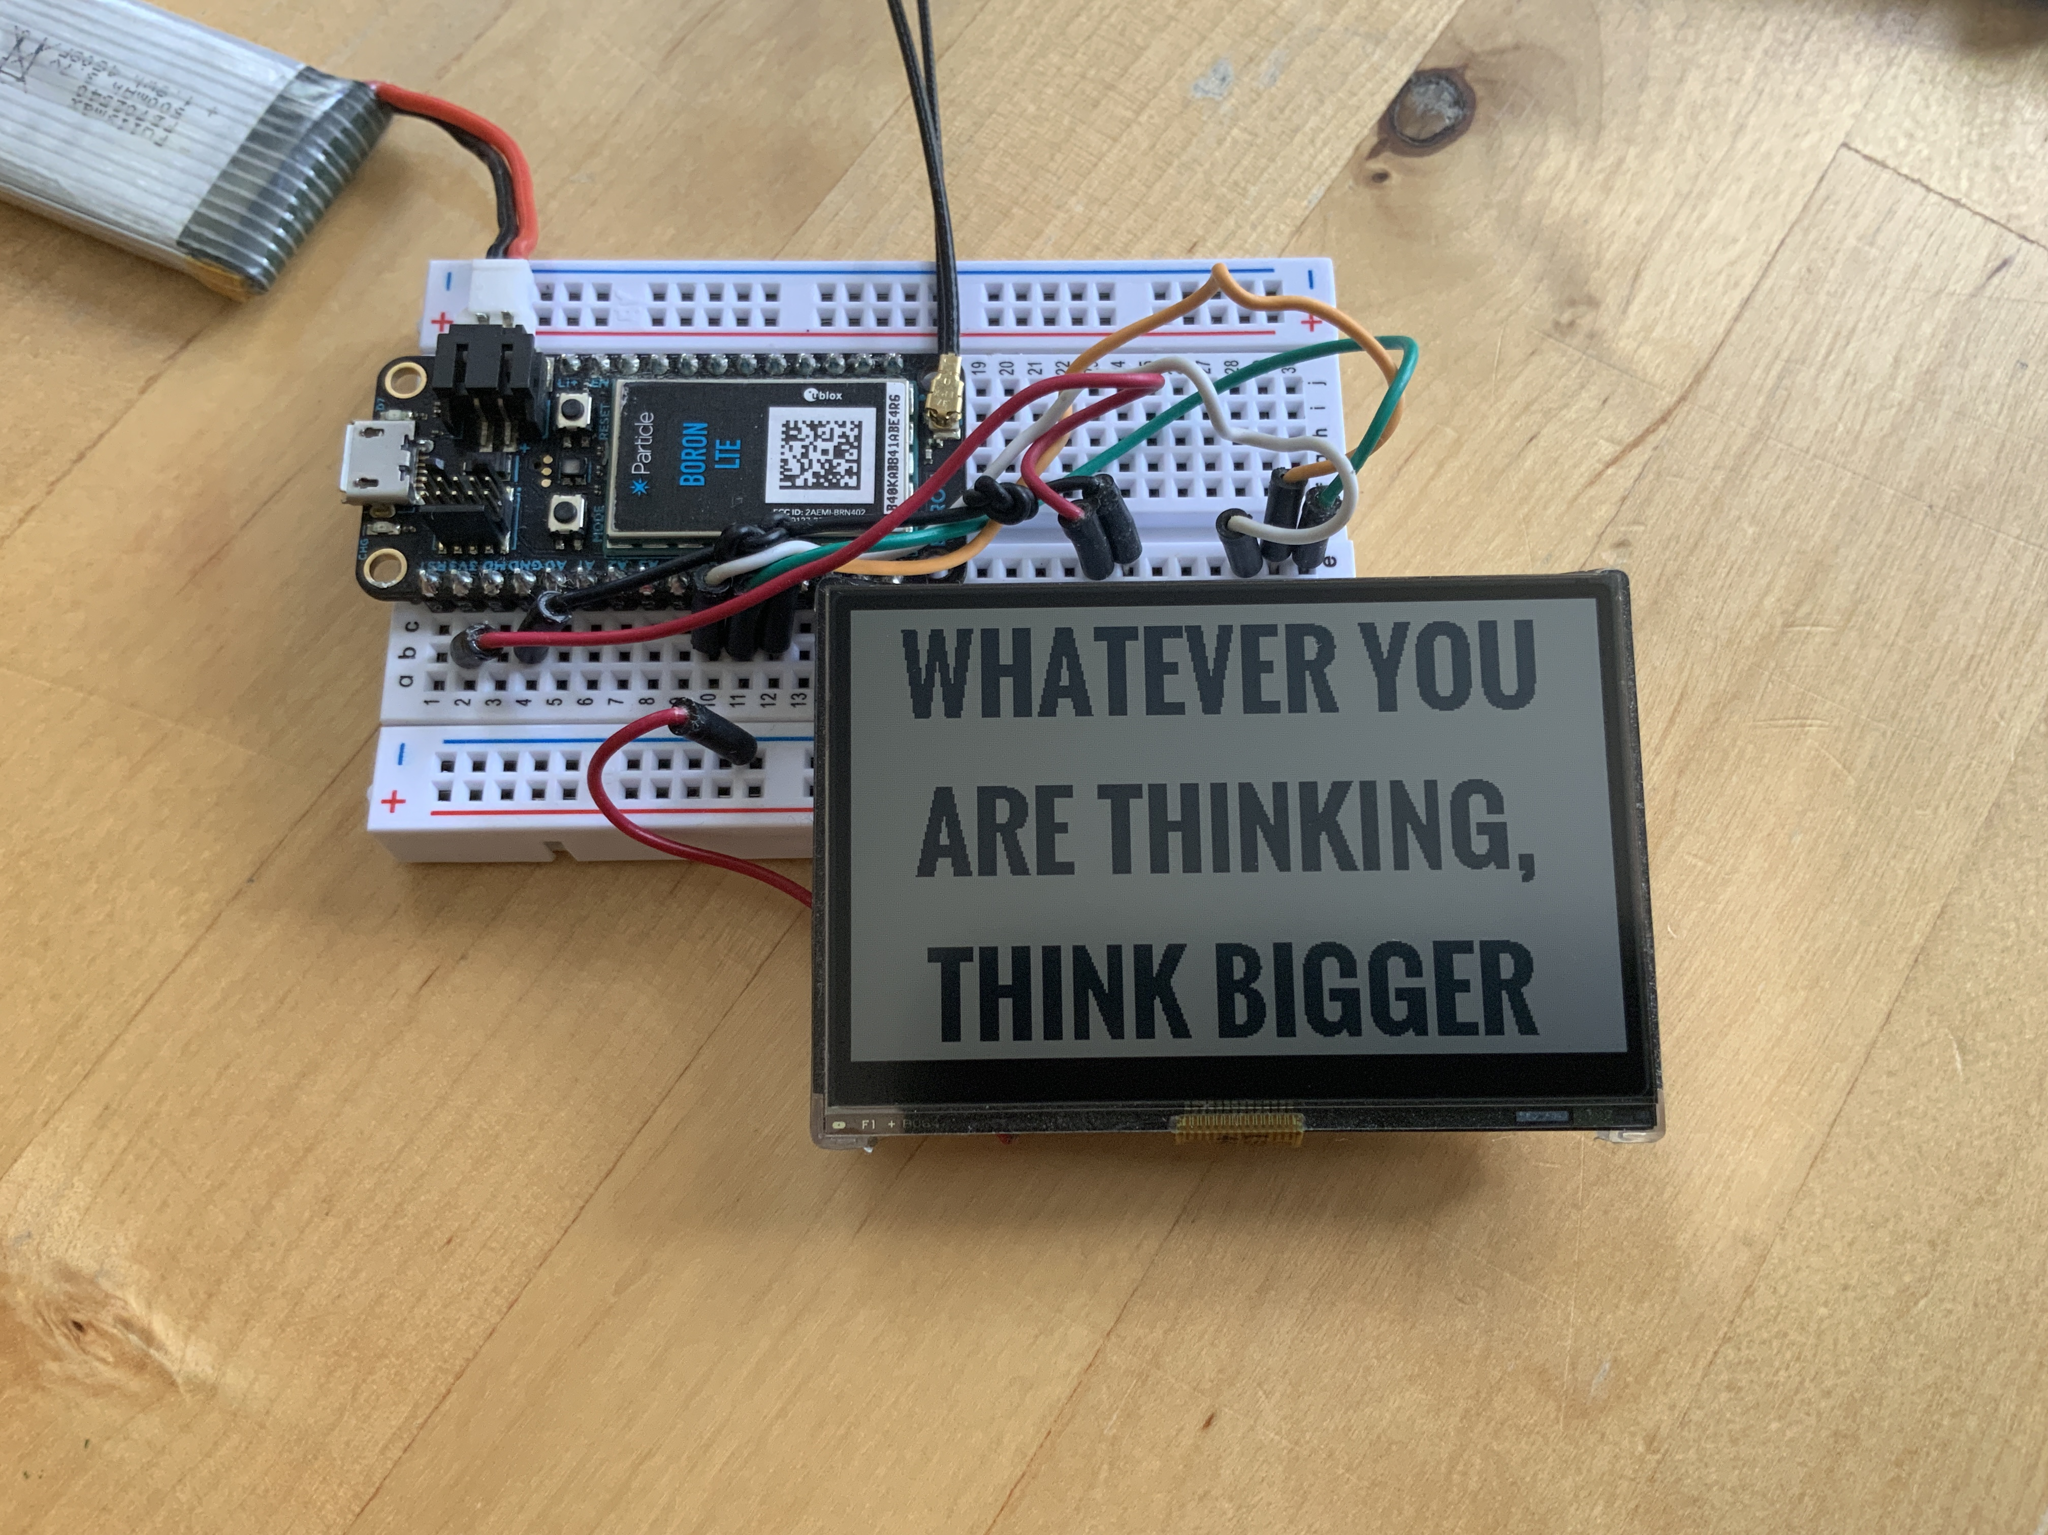
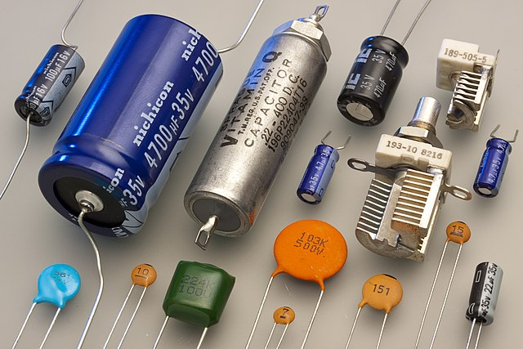
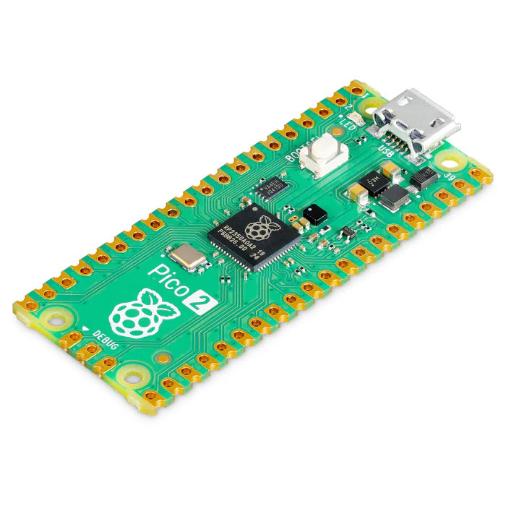
Charge Cycle

Slide 5
Charge Cycle- Detailed

Slide 6
Charge Cycle- Detailed
Photovoltaic Panel- 50uA-20mA
(500lux-outdoor sun- 30mm^2-70mm^2
Memory-In-Pixel
250uW/2Hz/89mmx67mm (4.4”)
RP2350 - 16mAh= 37 min-5.62 hrs (w/30F-250F)
Hybrid Capacitor (30F-250F=10-90mAh)

Slide 7
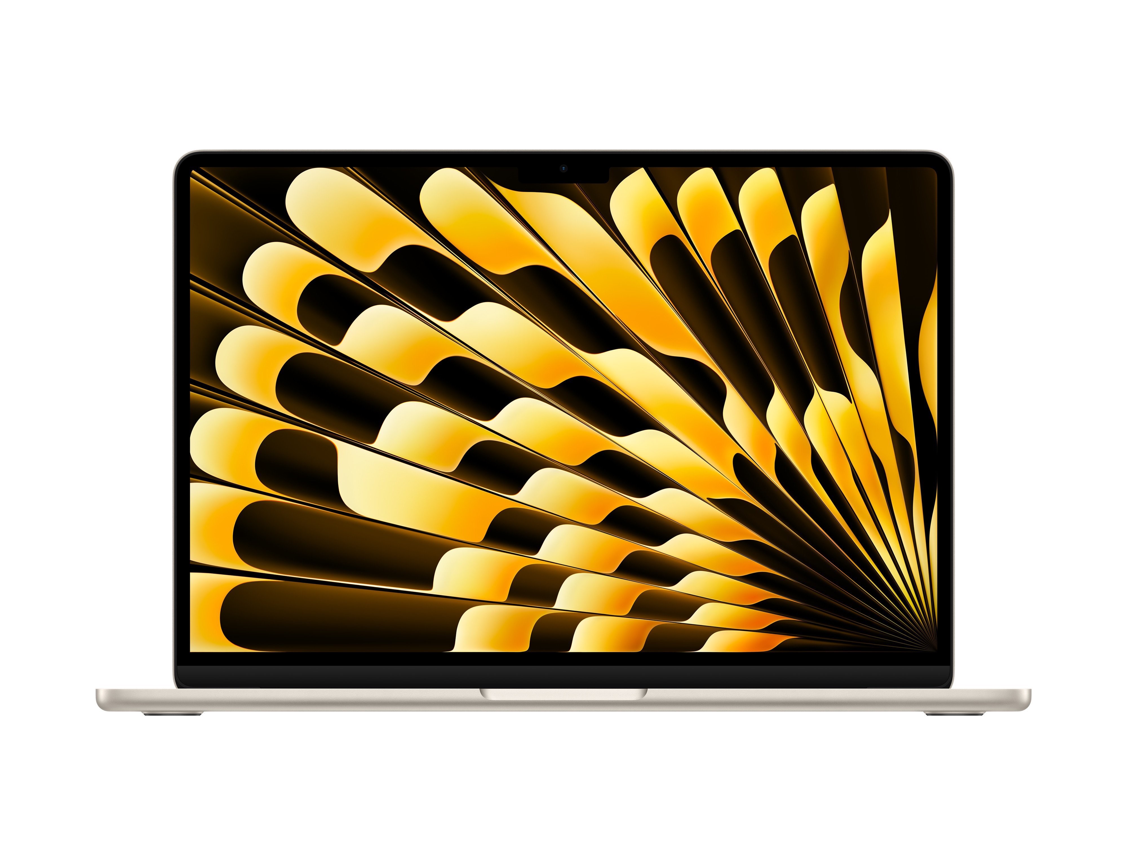
Microcontrollers can be solar powered today with tiny panels. What about laptops?
Macbook Air M3 13” (2024)

Slide 8
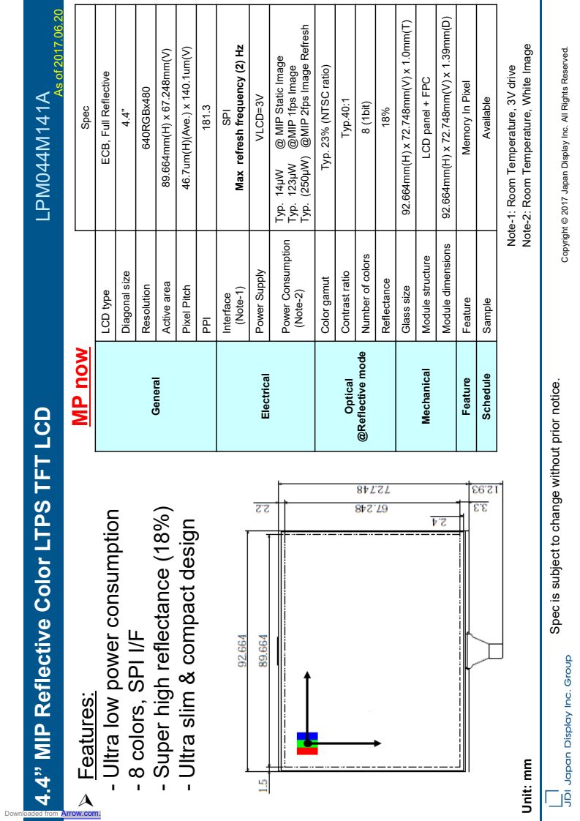
Microcontrollers can be solar powered today. What about laptops?
Displays consume a large portion of a system power consumption budget, and Memory-In-Pixels are not manufactured in sizes larger
than 4.4” and inventory appears to be obscure/low, special order and/or very expensive ($95+ for 4.4”). But can it scale? See next slide

Slide 9
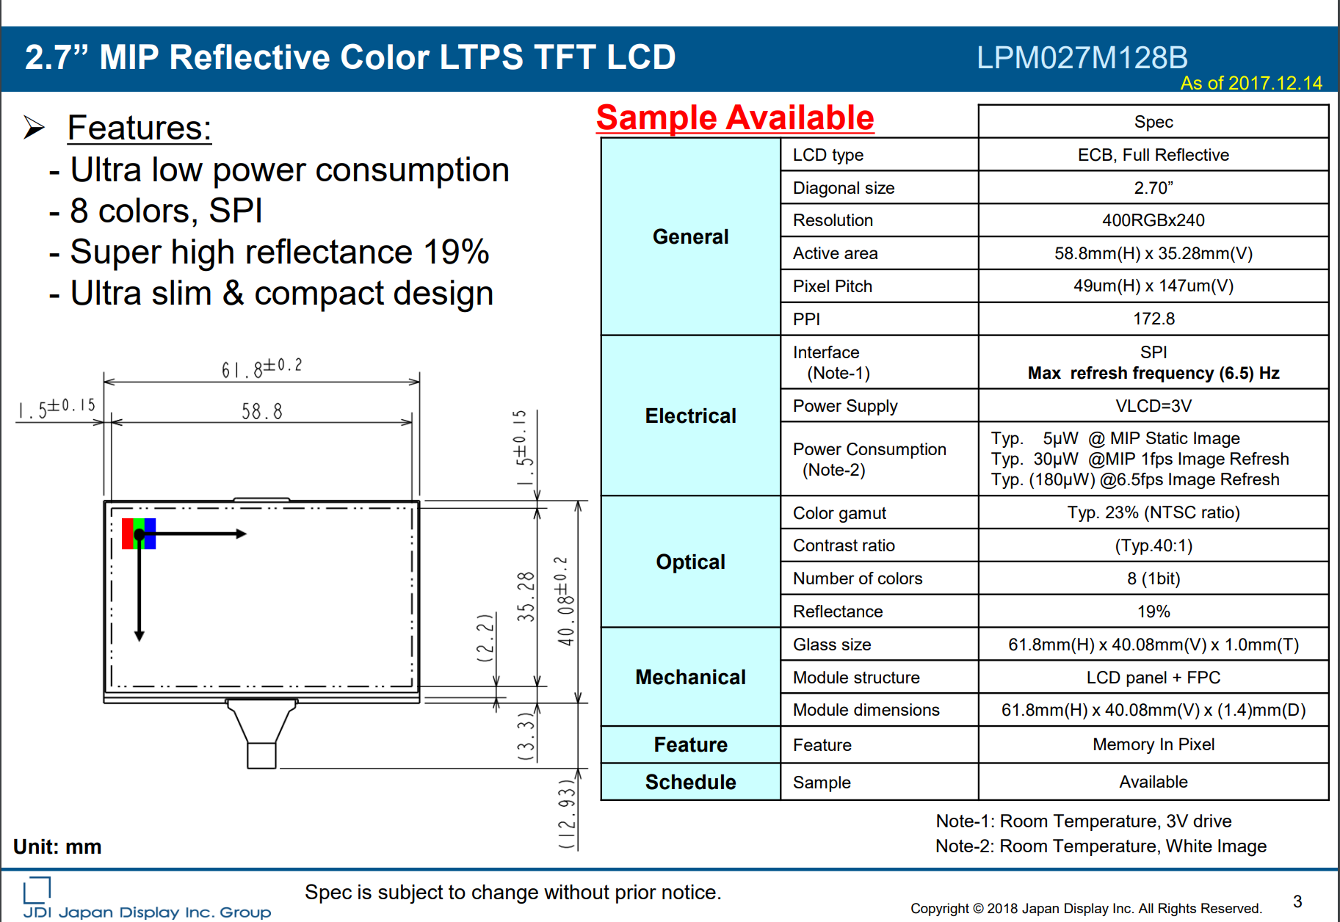
Can it scale? (the display, that is)
This 2.7” display uses 30uW for 1fps, and 180uW for 6.5fps
This 4.4” display uses 123uW for 1fps, and 250uW for 2fps.

Slide 10
Can it scale? (the display, that is)
This 2.7” display uses 30uW for 1fps, and 180uW for 6.5fps
This 4.4” display uses 123uW for 2fps, and 250uW for 2fps.
Logic suggests Yes

Slide 11
Is scaling it to 13.2” (relatively) easily solar powerable?(A Macbook Air is 13.6” diagonal)
This 2.7” display uses 30uW for 1fps, and 180uW for 6.5fps
This 4.4” display uses 123uW for 2fps, and 250uW for 2fps.

Slide 12
Is scaling it to 13.2” (relatively) easily solar powerable? Logic suggests Yes
Six 4.4” panels in a 3x2 array would produce a 13.2” display with 1920x960 resolution
Ignoring SPI bandwidth limits, tiling drivers, bezels, and the manufacture of an un-segmented 13.2” for the time being, six 4.4” MiP displays would consume 1.5mW at 2fps, 3mW at 4fps & 6mW @8fps.
8fps is not super fast for typing or browsing
However, it could be an option for solar power.
A 30fps hack does exist (for 2.7”): https://www.youtube.com/watch?v=X6Si2pwZe18
A 250F, 90mAh Hybrid Capacitor could power a 2mA microcontroller connected to a 2mA 13.2” display for 22.5 hrs (6mW/3V=2mA) [P=IV]
In practice, a low power keyboard, radio, and PS2/serial mouse would consume a little more.
This 4.4” display uses 123uW for 2fps, and 250uW for 2fps.

Slide 13
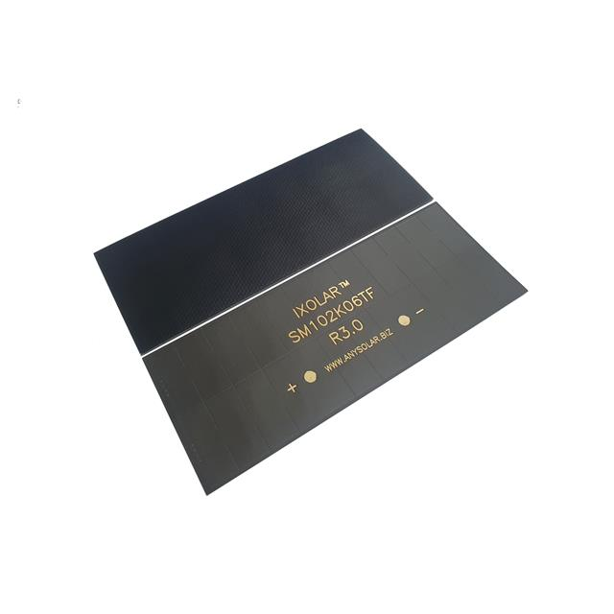
Is scaling it to 13.2” (relatively) easily solar powerable? Answer: Yes
A low-efficiency, inexpensive (<$2) 70mm^2 monocrystalline panel can generate 20mA in full sun. That suggests it would take 4hrs to charge a laptop’s 80mAh/250F hybrid capacitor to 89%
More efficient panels exist: One of the highest efficiency panels is made by ANYSOLAR:
https://www.digikey.com/en/products/detail/anysolar-ltd/KXOB201K04TF-TR/13999209
Up to 25% efficient: 78.7 mA (23mm x 42mm)
The largest panels can produce up to 409mA within 5.2”x2.0” (133mm x 52mm) - $29, small enough to fit on a laptop lid/bezel
i.e https://www.digikey.com/en/products/detail/anysolar-ltd/SM102K06TF/14311425
A 409mA 5.2” panel in full sun would charge a 90mAh battery/lithium ion capacitor in 13 minutes.

Slide 14
Is scaling it to 13.2” cost-effective? Depends on customer
Premium for highest efficiency PV panels, MiP displays, &
chip development (e.g. 22/14nm nanometer TSMC
/Global Foundries, but paying for energy independence
Efforts to reduce cost of lowest power displays would
benefit industry firsts (e.g. improving yields from defects
such as single dead pixels in large displays),
but requires additional capital
Lowering energy consumption of CPU and RAM has
more immediate production benefits= smaller,
wider applications than consumer/medical/automotive
displays- can be used as IoT, without human interaction
Display manufacturing is a human priority-aesthetics
are often a secondary concern for Machine to Machine
products, but can have a protective effect(e.g. eye health)
for consumers
Modularity is key to allowing platform to evolve/upgrade
to faster processors, modems, and storage <80mA. Speed
of processing exceeds human readability in Solar-
powerable microcontrollers
Integration of components =$$-$$$

Slide 15
giovanni dot lostumbo at gmail.com
Thanks for your time

